Slide 1
Batch Normalization
In International Conference on Machine Learning, 2015

Slide 2
Contents
Learning Problem in DNN: Internal Covariate Shift
Batch Normalization
Advantage of Batch Norm.
Experiment
Other Methods

Slide 3
Learning Problem in DNN
Training ANN is difficult
Due to many parameters
Output
Input

Slide 4



Learning Problem in DNN
Training ANN is difficult
Due to many parameters
Output
$$O$$
$$H$$
$$x$$
Input

Slide 5





Learning Problem in DNN
$$O$$
Training DNN is more difficult
Due to many parameters
$$H_{3}$$
$$O$$
$$H_{2}$$
$$H$$
$$H_{1}$$
$$x$$
$$x$$
Input

Slide 6
Learning Problem in DNN
$$O$$
Training DNN is more difficult
Due to many parameters
Small change in all weights could make vary different value in upper layer
$$H_{3}$$
$$H_{2}$$
$$H_{1}$$
$$x$$

Slide 7
Learning Problem in DNN
$$O$$
Training DNN is more difficult
Due to many parameters
Small change in all weights could make vary different value in upper layer
$$H_{3}$$
$$H_{2}$$
$$H_{1}$$
$$x$$

Slide 8




Learning Problem in DNN
$$O$$
$$O$$
Training DNN is more difficult
Due to many parameters
Small change in all weights could make vary different value in upper layer
$$H_{3}$$
$$H_{3}$$
$$H_{2}$$
$$H_{2}$$
$$H_{1}$$
$$H_{1}$$
$$x$$

Slide 9



Learning Problem in DNN
$$O$$
$$O$$
$$O$$
Training DNN is more difficult
Due to many parameters
Small change in all weights could make vary different value in upper layer
$$H_{3}$$
$$H_{3}$$
$$H_{3}$$
$$H_{2}$$
$$H_{2}$$
$$H_{2}$$
$$H_{1}$$
$$H_{1}$$
$$H_{1}$$
$$x$$

Slide 10


Learning Problem in DNN
$$O$$
$$O$$
Training DNN is more difficult
Due to many parameters
Small change in all weights could make vary different value in upper layer
$$H_{3}$$
$$H_{3}$$
$$H_{2}$$
$$H_{2}$$
$$H_{1}$$
$$H_{1}$$
$$x$$

Slide 11
Learning Problem in DNN
$$O$$
$$O$$
This variance is called
'Internal Covariate Shift'
$$H_{3}$$
$$H_{3}$$
$$H_{2}$$
$$H_{2}$$
$$H_{1}$$
$$H_{1}$$
$$x$$

Slide 12
Learning Problem in DNN
$$O$$
This variance is called
'Internal Covariate Shift'
$$H_{3}$$
$$H_{2}$$
$$H_{1}$$
$$x$$

Slide 13
Learning Problem in DNN
$$O$$
This variance is called
'Internal Covariate Shift'
$$H_{3}$$
?
?
?
?
$$H_{2}$$
$$H_{2}$$
$$H_{1}$$
$$H_{1}$$
$$x$$

Slide 14
Learning Problem in DNN
$$O$$
This variance is called
'Internal Covariate Shift'
$$H_{3}$$
?
?
?
?
$$H_{2}$$
$$H_{2}$$
Training
Testing
$$H_{1}$$
$$H_{1}$$
H
$$x$$
It is similar to the problem
where dist. of training and testing are different

Slide 15
Learning Problem in DNN
$$O$$
$$O$$
This variance is called
'Internal Covariate Shift'
$$H_{3}$$
$$H_{3}$$
$$H_{2}$$
$$H_{2}$$
Training (Time 1)
Training (Time 2)
$$H_{1}$$
$$H_{1}$$
H
$$x$$
The distribution of each layer`s input changes during training

Slide 16




Learning Problem in DNN
$$O$$
$$O$$
To address this Internal Covariate Shift problem, previous studies used
careful initialization
small learning rate
$$H_{3}$$
$$H_{2}$$
$$H_{2}$$
$$H_{2}$$
$$H_{1}$$
$$H_{1}$$
$$x$$

Slide 17
Learning Problem in DNN
$$O$$
$$O$$
To address this Internal Covariate Shift problem, previous studies used
careful initialization
small learning rate
$$H_{3}$$
$$H_{2}$$
Difficult
$$H_{2}$$
$$H_{2}$$
Slow
$$H_{1}$$
$$H_{1}$$
$$x$$

Slide 18
Batch Normalization
$$O$$
To make training speed fast and easy learning,
Batch Norm. is proposed
$$H_{3}$$
$$H_{2}$$
$$H_{1}$$
$$x$$

Slide 19
Batch Normalization
$$O$$
To make training speed fast and easy learning,
Batch Norm. is proposed
$$H_{3}$$
It assume that
if the change of dist. is not large,
training weight parameter is easy
$$H_{2}$$
$$H_{1}$$
$$x$$

Slide 20

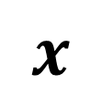



Batch Normalization
$$O$$
To make training speed fast and easy learning,
Batch Norm. is proposed
$$H_{3}$$
$$H_{2}$$
$$H_{1}$$
$$Activation$$
$$H_{1}$$
Changing Part:
$$wx$$
$$x$$
$$w$$
$$x$$

Slide 21


Batch Normalization
$$O$$
To make training speed fast and easy learning,
Batch Norm. is proposed
$$H_{3}$$
$$H_{2}$$
$$H_{1}$$
$$H_{1}$$
$$Activation$$
$$H_{1}$$
Changing Part:
$$wx$$
$$wx$$
$$x$$
$$w$$
$$x$$

Slide 22
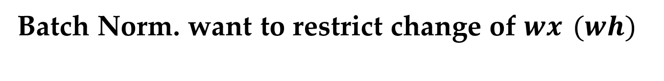
Batch Normalization
$$O$$
Batch Norm. want to restrict change of $wx$ $(wh)$
$$H_{3}$$
$$H_{2}$$
$$H_{1}$$
$$H_{1}$$
$$Activation$$
$$H_{1}$$
$$wx$$
Changing Part:
BN
$$wx$$
$$x$$
$$w$$
$$x$$

Slide 23


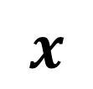
Batch Normalization
$$O$$
Batch Norm. want to restrict change of $wx$ $(wh)$
$$H_{3}$$
$$H_{2}$$
$$H_{1}$$
$$H_{1}$$
$$H_{1}$$
$$Activation$$
$$H_{1}$$
BN
$$wx$$
Changing Part:
BN
$$wx$$
$$wx$$
$$x$$
$$w$$
$$x$$
$$x$$

Slide 24
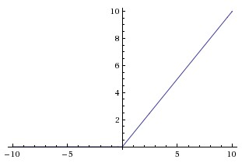

$$H_{1}$$
$$H_{1}$$
$$Activation$$
$$wx$$
$$wx$$
$$wx$$
$$w$$
$$x$$
$$x$$

Slide 25
$$H_{1}$$
$$H_{1}$$
$$Activation$$
BN
$$wx$$
$$wx$$
$$wx$$
$$w$$
$$x$$
$$x$$

Slide 26
$$H_{1}$$
$$H_{1}$$
$$Activation$$
BN
$$wx$$
$$wx$$
$$wx$$
$$w$$
$$x$$
$$x$$

Slide 27


$$H_{1}$$
$$H_{1}$$
$$Activation$$
BN
$$wx$$
$$wx$$
$$wx$$
$$wx$$
$$wx$$
$$w$$
$$x$$
$$x$$

Slide 28
$$H_{1}$$
$$H_{1}$$
$$Activation$$
BN
$$wx$$
$$wx$$
$$wx$$
$$wx$$
$$wx$$
$$w$$
$$x$$
$$x$$

Slide 29


BN
$$wh$$
$$wh$$
$$H_{1}$$
$$H_{1}$$
$$Activation$$
BN
$$wx$$
$$wx$$
$$wx$$
$$wx$$
$$wx$$
$$w$$
$$x$$
$$x$$

Slide 30


$$H_{2}$$
BN
$$wh$$
$$wh$$
$$wx$$
$$H_{1}$$
$$H_{1}$$
$$Activation$$
BN
$$wx$$
$$wx$$
$$wx$$
$$wx$$
$$wx$$
$$w$$
$$x$$
$$x$$

Slide 31




$$H_{2}$$
$$H_{2}$$
$$H_{2}$$
BN
$$wh$$
$$wh$$
$$wh$$
$$wx$$
$$H_{1}$$
$$H_{1}$$
$$H_{1}$$
$$Activation$$
BN
$$wx$$
$$wx$$
$$wx$$
$$wx$$
$$wx$$
$$w$$
$$x$$
$$x$$

Slide 32
Usually, 0 mean and 1 variance is preferred empirically

Slide 33
Usually, 0 mean and 1 variance is preferred empirically
if range is above or under 0, nonlinearity is not made (ReLU)

Slide 34
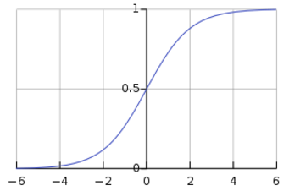
Usually, 0 mean and 1 variance is preferred empirically
if range exists in extreme value, vanishing gradient occur (Sigmoid)

Slide 35
Usually, 0 mean and 1 variance is preferred empirically
Small variance (= 1) is better than large variance : Internal Covariate Shift (ReLU)

Slide 36
Usually, 0 mean and 1 variance is preferred empirically
Small variance (= 1) is better than large variance : Internal Covariate Shift & Vanishing Gradient (Sigmoid)

Slide 37








$$H_{2}$$
BN
$$wh$$
$$wx$$
$$H_{1}$$
BN
$${BN}_{1}$$
$${BN}_{2}$$
$${BN}_{3}$$
$$wx$$
$$wx$$
$$z_{1}$$
$$z_{1}$$
$$z_{1}$$
$$x$$
$$x_{1}$$
$$x_{2}$$

Slide 38
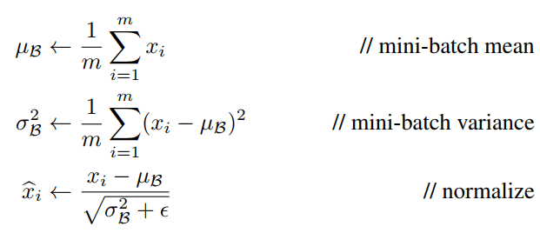
$$H_{2}$$
BN
$$wh$$
$$wx$$
$$H_{1}$$
BN
$${BN}_{1}$$
$${BN}_{2}$$
$${BN}_{3}$$
$$wx$$
$$wx$$
$$z_{1}$$
$$z_{1}$$
$$z_{1}$$
$$x$$
$$x_{1}$$
$$x_{2}$$

Slide 39

$$H_{2}$$
BN
$$wh$$
$$wx$$
$$H_{1}$$
BN
$$wx$$
$$wx$$
$$x$$

Slide 40
0 mean and 1 variance is preferred
But it is not best
$$H_{2}$$
BN
$$wh$$
$$wx$$
Dead
More non dead
$$H_{1}$$
BN
$$wx$$
$$wx$$
$$x$$

Slide 41
0 mean and 1 variance is preferred
But it is not best
$$H_{2}$$
BN
Not nonlinear
nonlinear
$$wh$$
$$wx$$
$$H_{1}$$
BN
$$wx$$
$$wx$$
$$x$$

Slide 42
0 mean and 1 variance is preferred
But it is not best
$$H_{2}$$
BN
Not nonlinear
nonlinear
$$wh$$
$$wx$$
$$H_{1}$$
BN
$$wx$$
$$wx$$
Scale, shift parameter could be learned using backpropagation
$$x$$

Slide 43
Advantage of Batch Norm.
$$H_{2}$$
Higher learning rate is possible
Less careful initialization
Because 'Internal Covariate Shift' problem is alleviated
BN
$$wh$$
$$wx$$
$$H_{1}$$
BN
$$wx$$
$$wx$$
$$x$$

Slide 44
Advantage of Batch Norm.
$$H_{2}$$
Regularization Effect (So, Dropout is not necessary)
Because Mini-batch statistics x, E, Var is not deterministic but stochastic
BN
$$wh$$
$$wx$$
$$H_{1}$$
BN
$$wx$$
$$wx$$
$$x$$

Slide 45
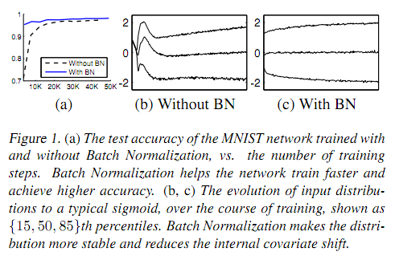
Experiment

Slide 46
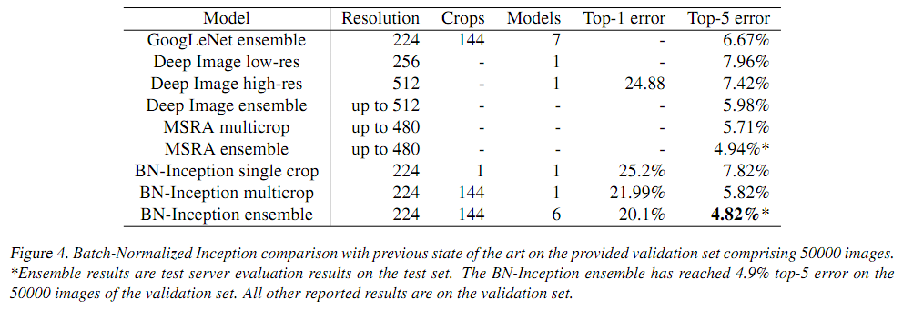
Experiment

Slide 47
Conclusion
Batch norm. is proposed to address 'Internal covariate shift'
This is done by restricting input range of activation function
The advantages of Batch norm. are
Fast learning
Less careful initialization
Regularization effect

Slide 48
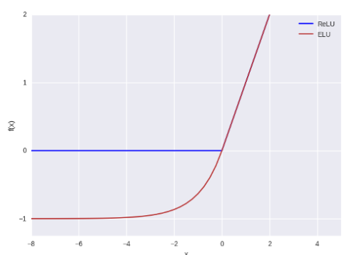

Other methods
Exponential Linear Unit (ELU) doesn`t need batch norm.
Act. Value
0
-1
0
Input

Slide 49
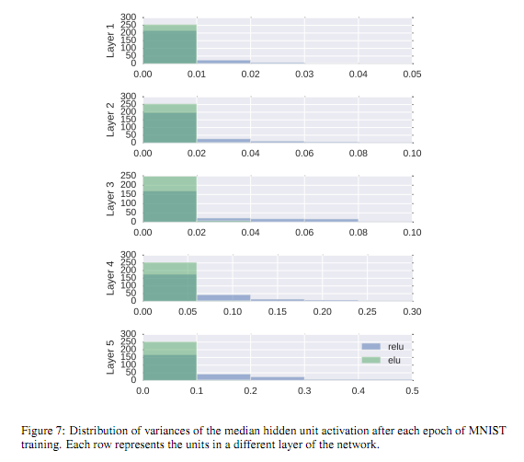
Other methods
Exponential Linear Unit (ELU) doesn`t need batch norm.
Act. Value
0
-1
0
Input

Slide 50
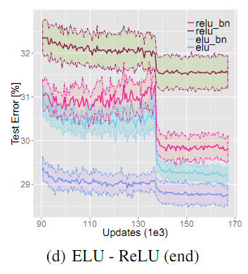
Other methods
Exponential Linear Unit (ELU) doesn`t need batch norm.
Act. Value
0
-1
0
Input

Slide 51
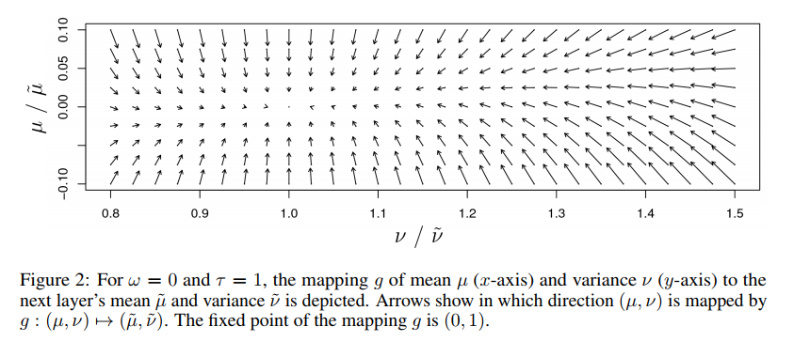
Other methods
lamda: 1.0507
alpha: 1.6733
Scaled Exponential Linear Unit (SELU) doesn`t need batch norm. (Self-Normalizing Neural network)

Slide 52
Q & A

